Slide 1
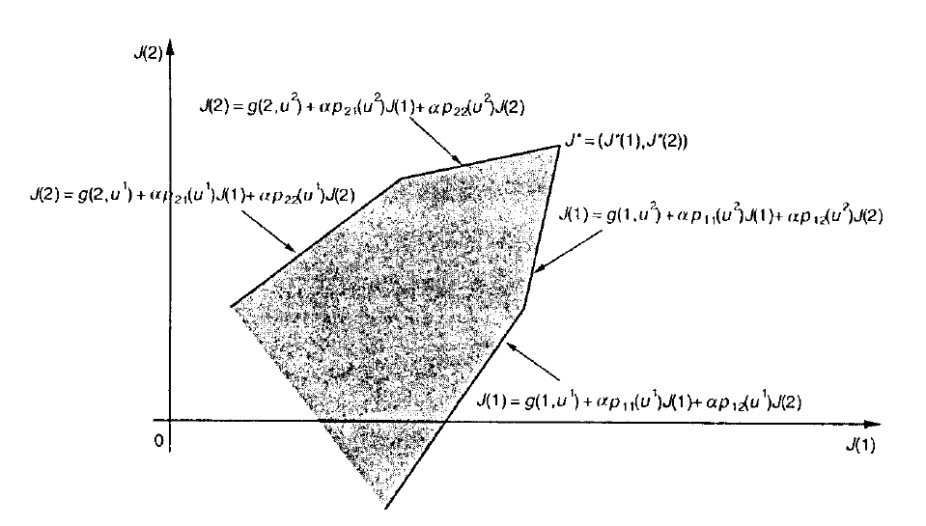




$$v(1)$$
$$v\left(1\right)=g\left(1,u^{1}\right)+αp_{11}\left(u^{1}\right)v\left(1\right)+αp_{12}\left(u^{1}\right)v(2)$$
$$v\left(2\right)=g\left(2,u^{1}\right)+αp_{21}\left(u^{1}\right)v\left(1\right)+αp_{22}\left(u^{1}\right)v(2)$$
$$v\left(1\right)=g\left(1,u^{2}\right)+αp_{11}\left(u^{2}\right)v\left(1\right)+αp_{12}\left(u^{2}\right)v(2)$$
$$v\left(2\right)=g\left(2,u^{2}\right)+αp_{21}\left(u^{2}\right)v\left(1\right)+αp_{22}\left(u^{2}\right)v(2)$$
$$v^{∗}=(v\left(1\right),v(2))$$
$$v(2)$$

